Slide 1
Praktikum: Cloud Data Bases (IN0012, IN2106, IN4163)
by Aly Kamel, Iremur Kidil, Ricardo Kraft
28.01.2020

Slide 2
Overview
Motivation
Use case
Demands of the client
Implementation
Demonstration
Perfomance Tests
Experimental setup
Diagramms
Conclusion
Pros and Cons
Recommendation of the extension
References
Discussion

Slide 3
I. Motivation: Redis Pub/Sub Principle
TOPIC
Sender
(Publisher)
Subscribes
Receiver N
(Subscriber)
Publishes
Receives
MSG
MSG
MSG
MSG
MSG
MSG

Slide 4
I. Motivation: The Group Chat
CHAT ROOM
MSG
MSG
Client N
Sends
Sends
Client N
Receives
Receives
MSG
MSG
MSG
MSG
MSG
MSG
MSG
MSG
4

Slide 5


II. Use Case Scenario
Cookie Factory
Global-Chat
NEW YORK
MUNICH
NYC MANAGER
MUC MANAGER
NYC-Chat
MUC-Chat
Brooklyn
Queens
Bronx
Garching
Pasing
Laim
5

Slide 6





III. Demands of the client
Saving the chat history
Unique usernames
Access database while in the chatroom
Password protected private chatrooms
Public chatrooms
6

Slide 7
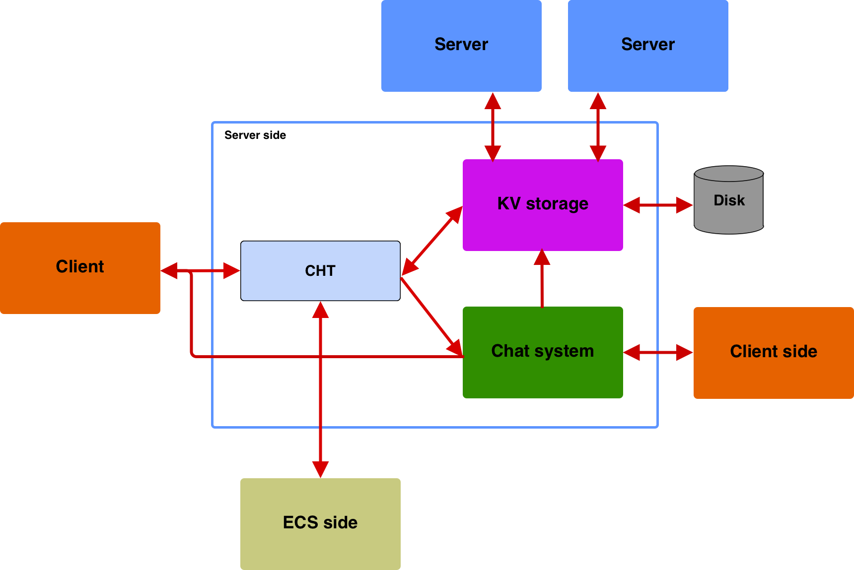
V. General Structure

Slide 8
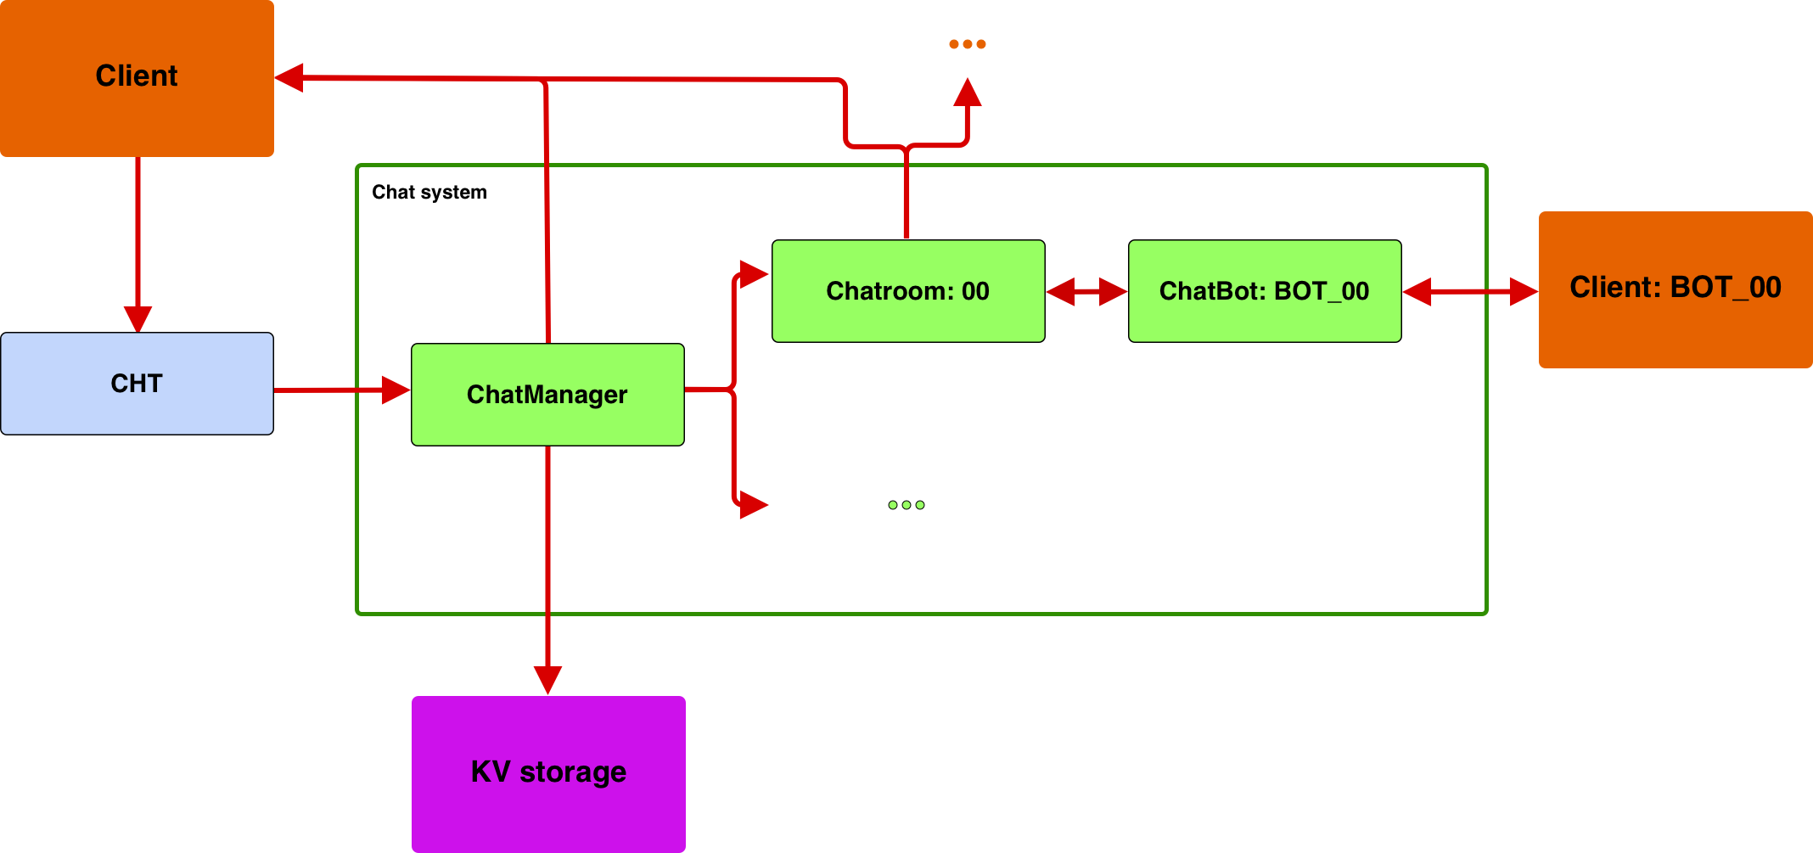
VI. The Chat System

Slide 9
Our solution
Unique Usernames
Connect with a name
Start a chatroom public (create/join it)
Simple chatting
Notifactions join and leave
Save chat history

Slide 10
<more complicated chat messages

Slide 11
Message Handling
Key-value server
User1: I have GET{n} coins.
n
5
ChatManager
User1: I have GET{n} coins.
ChatRoom
ChatBot
I have GET{n} coins.
User1: I have 5 coins.
User1: I have 5 coins.
User1
Clients in the chatroom

Slide 12
IV. Our Solution
I. Accessing Database via PUT & GET commands

Slide 13
IV. Our Solution
II. ACTIVE & WHISPER commands
WSP <user1><user2>,…,<userN>
Sends a whisper to provided clients.
ACTIVE
Returns a list of all users in the chatroom.

Slide 14
Private chatrooms
Cookie Factory
Password protection
Global-Chat
NEW YORK
MUNICH
NYC MANAGER
MUC MANAGER
NYC-Chat
MUC-Chat
Brooklyn
Queens
Bronx
Garching
Pasing
Laim
14
14

Slide 15
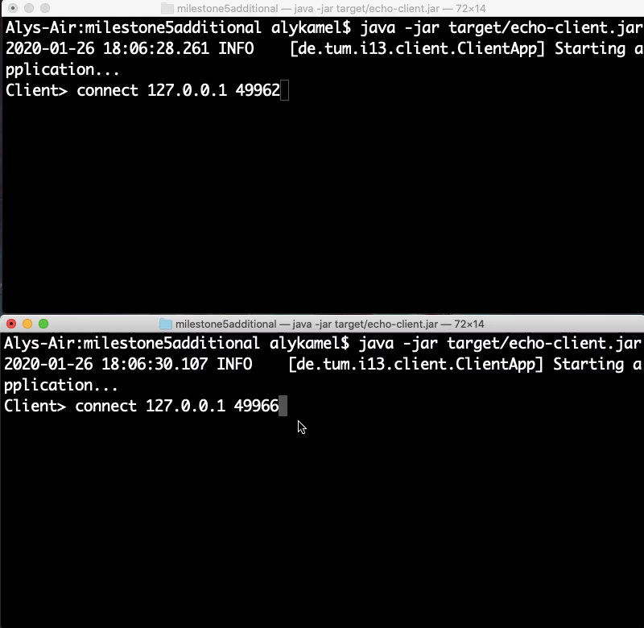
VII. Demonstration

Slide 16
IV. Performance
I. Experimental Setup
Variables:
M = Number of chatmessages
Y axis → Time in seconds
M/D = chatmessage per database operation

Slide 17
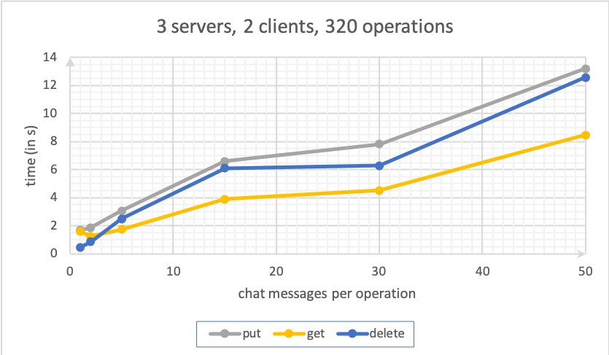

Slide 18
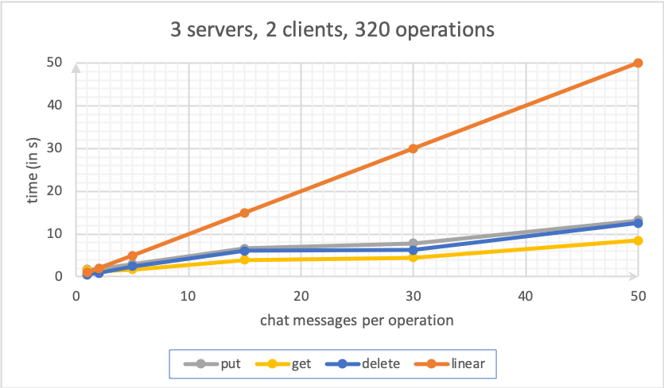

Slide 19
VII. Performance
I. Experimental setup
Variables:
M = Number of chatmessages
D = Number of database operations e.g. put, get, delete
M/D = chatmessage per database operation

Slide 20
VI. Performance
II. Graph 1
0 M/D
1 M/D
10 M/D
100 M/D
1000 M/D

Slide 21
VII. Conclusion
I. Pros and Cons
Pros
Good for short msg
Acces to database in chat
Arg 3
Cons
Many people need better overview
Arg2
Arg3
No pictures etc., just words

Slide 22
VII. Conclusion
II. Recommendation of the extension
The extension should or shouldn‘t be used for chat heavy systems because its holds/loses performance after a critical amount of messages/database operation
Then the client should consider to use a third party software
for the communication

Slide 23
THANK YOU FOR YOUR ATTENTION!

Slide 24
VIII. References
[1] Keshav, S. (2007). How to read a paper. ACM SIGCOMM Computer Communication Review, 37(3), 83.
[2] Levin et al. (2012). Logically centralized?: state distribution trade-offs in software defined networks. In Proceedings of the first workshop on Hot topics in software defined networks - HotSDN ’12 (p. 1). Workshop/conference venue

Slide 25
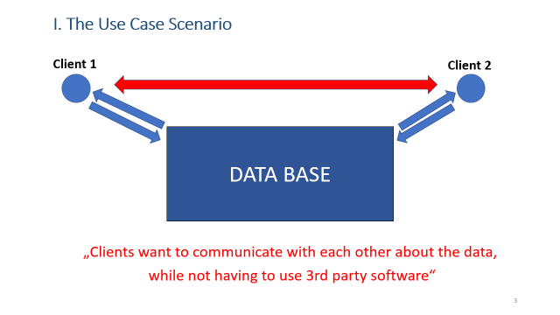
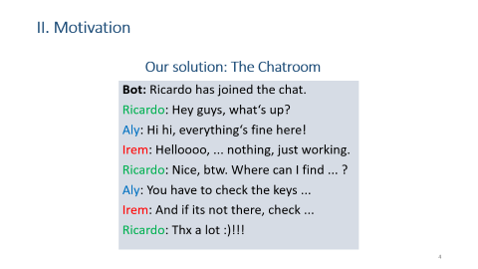
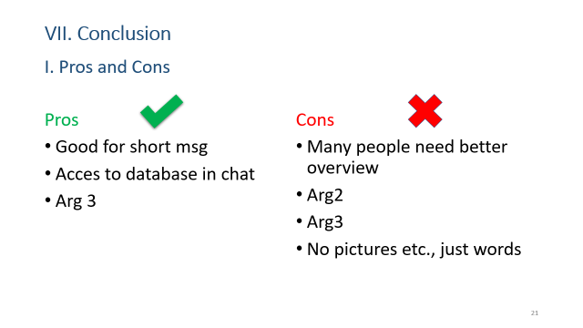
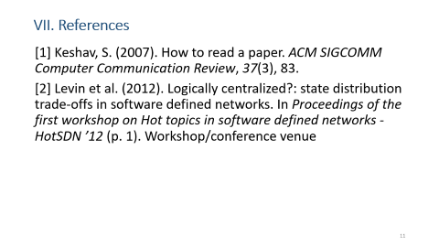
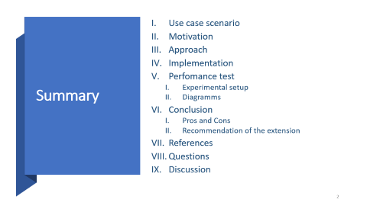
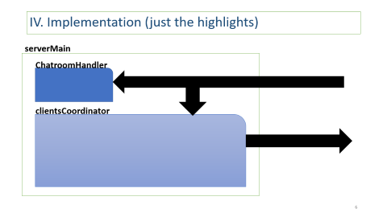
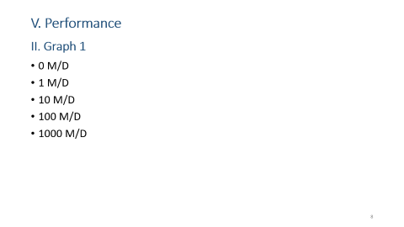
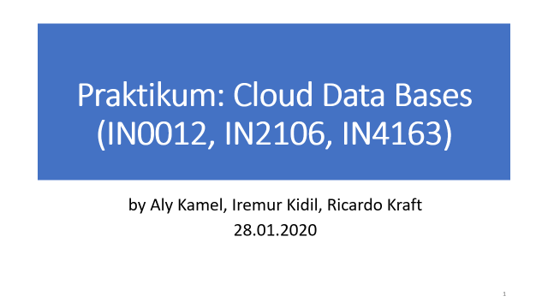
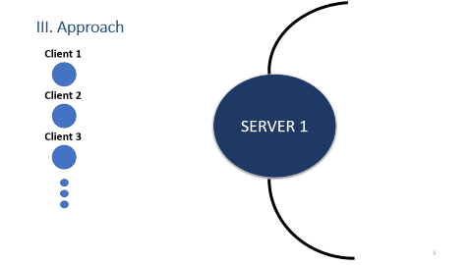
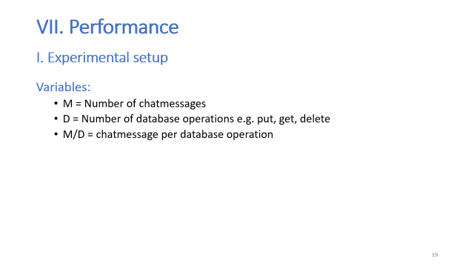
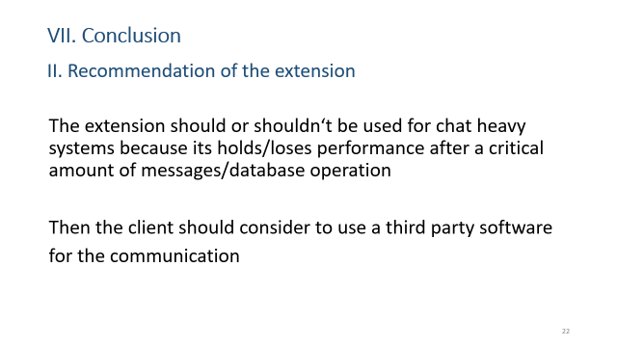


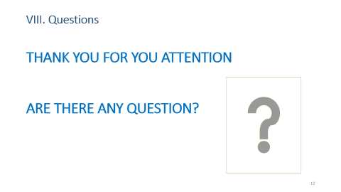
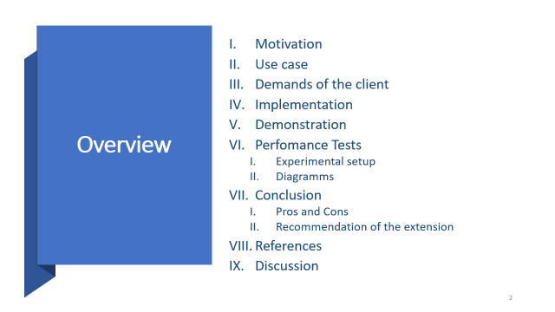
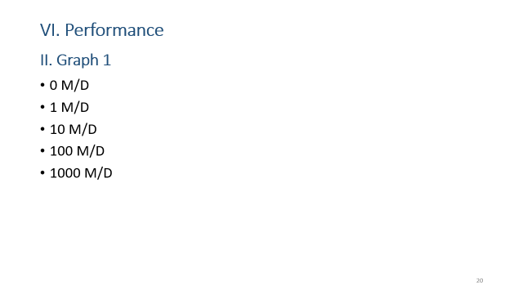

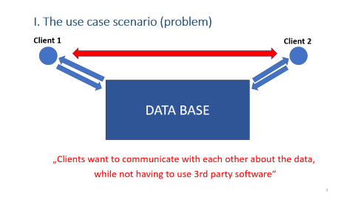
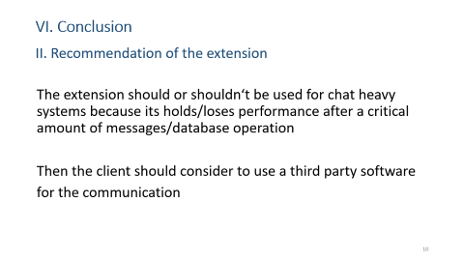
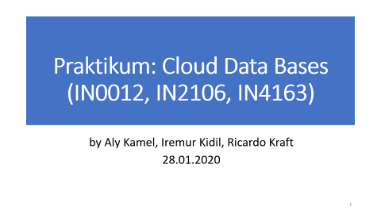

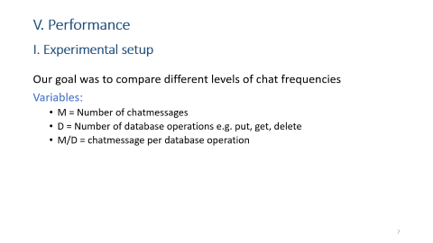

IX. Discussion

